Slide 1
Effects of Income Level on Disease Rates
Sam Clements
Alysia Dugan
David Mayorquin
Fionn McGreal
Hattie Oswald

Slide 2
Questions
The Big Question: What impact does income level have on infection rates of preventable diseases?
High-level:
What is the average income for each state?
How many reported cases of various diseases are there in each state?
Is there a correlation between a state’s average income level and the prevalence of certain diseases?

Slide 3
Data Used
Two main areas where data was needed:
Income
US Census American Community Survey – 1 Year
https://api.census.gov/data/{year}/acs/acs1?get=NAME,group(B01001)&for=us:1
Disease
HealthData.gov – parsed by David Roberts on Kaggle
https://www.kaggle.com/davidbroberts/diseases-in-the-us-1916-to-2011

Slide 4
Clean Up Process
Epiweek – used by CDC, but not a usable date format
Split into Year and Week and placed in new columns
Cases listed as objects in DataFrame
Removed blanks and converted to integers
Census data lists state names in full, disease data listed abbreviations
Changed state names in census data to abbreviations to allow for DataFrames to be merged
Needed to integrate a loop to pull multiple years from Census API

Slide 5
Data Cleanup Insights
The file with disease data that we pulled (1916-2011) had 8 diseases listed
We extracted just 2006-2010 to analyze and found only two of those diseases remaining
When were the last recorded instances of the other six diseases?

Slide 6
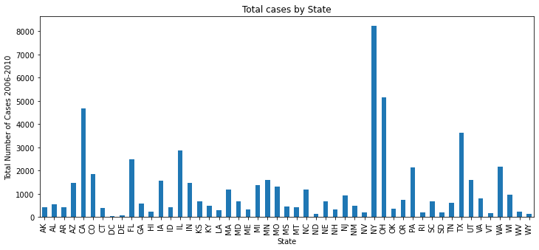
Which states have the highest instances of disease?

Slide 7
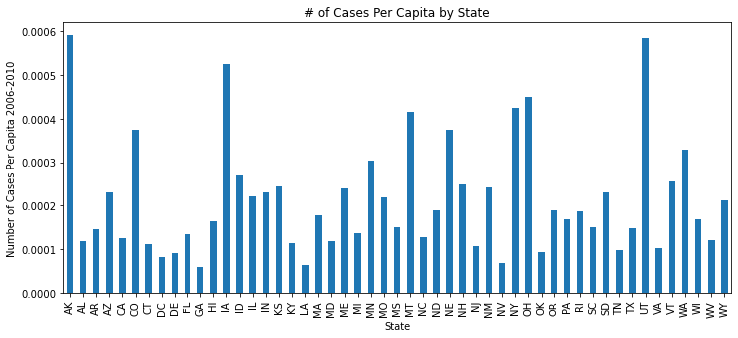
Which states have the highest disease rates per capita?

Slide 8
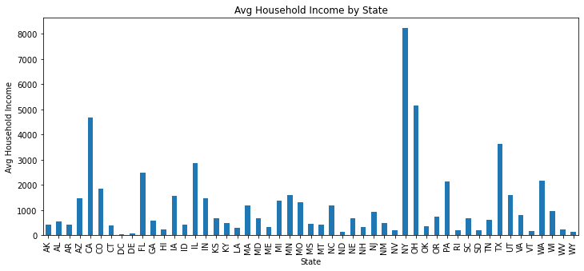
Which states have the highest/lowest average income?

Slide 9
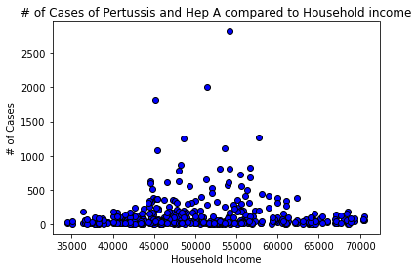
Overall Income vs Cases
The correlation between both factors is 0.05

Slide 10
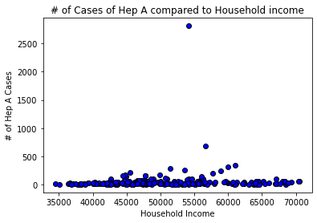
Hepatitis A vs Average Income
The correlation between both factors is 0.08

Slide 11
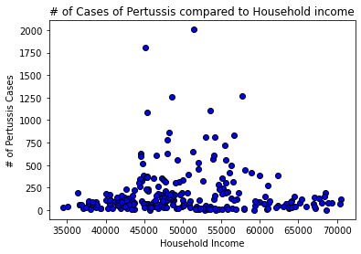
Pertussis vs Average Income
The correlation between both factors is 0.02

Slide 12
Conclusions
Correlation scatterplot shows that instances of disease are higher in lower income states
Average income at which cases start to drop off was higher than expected
Lower income is associated with many contributing factors to higher rates of disease, including:
Lack of access to care and affordable health insurance
Lower quality education, both from underfunded schools and an inability to afford higher education

Slide 13

Post-Mortem
When did the other diseases get eliminated or drop so low that they stopped being reported?
Is there a correlation between the states with the highest/lowest infection rates and the highest/lowest average income?
Track changes over time – chart each year to see how it changes
What other contributing factors could be added to the analysis? Religion? Climate? Population density?

